Slide 1
Design Tagging System

Slide 3
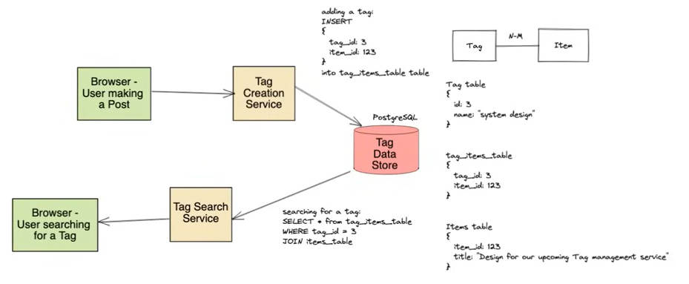
Approach 1: 1 Db to handle read/write

Slide 4
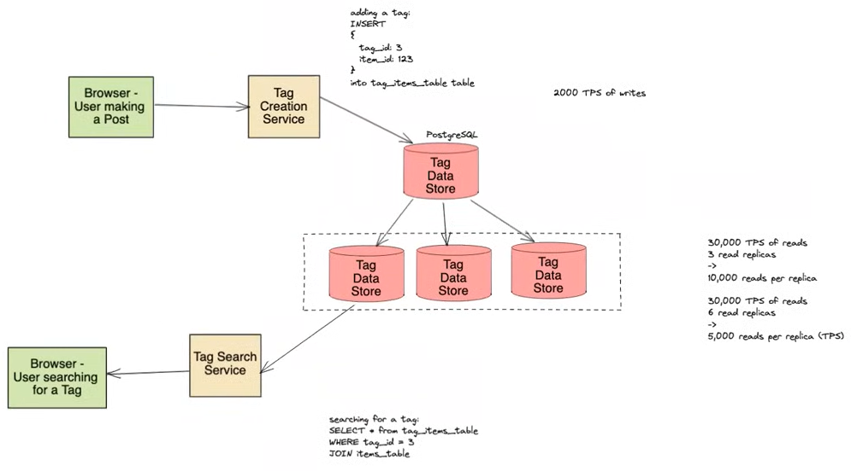
Approach 2: Read replicas for read heavy

